Slide 1
Understanding cell penetration by stapled peptides
L

Slide 2
Flow of Talk
Background and introduction (paper review)
Data mining of data from paper
Comparisons to linear peptides

Slide 3
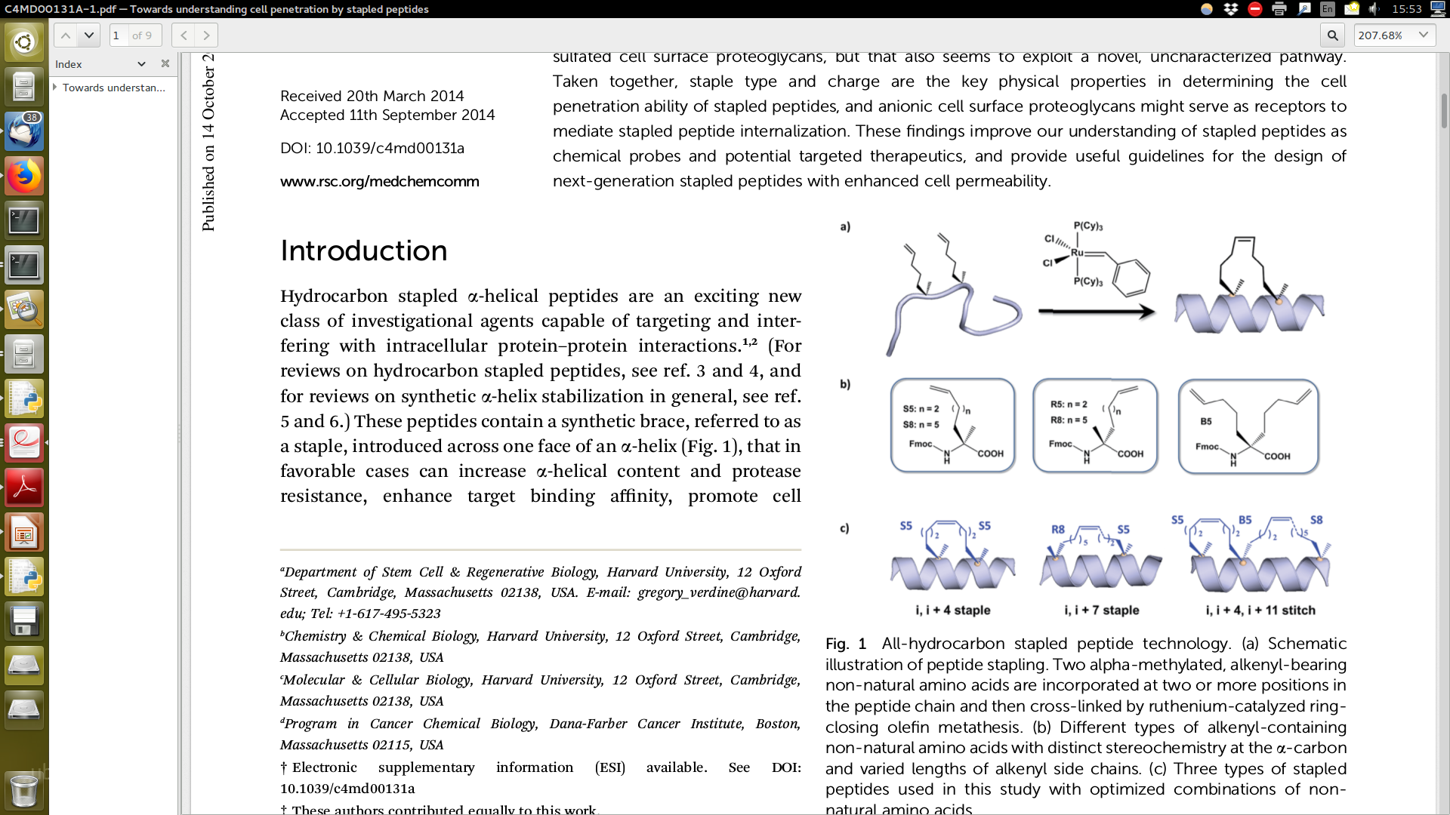
stapled vs non-stapled peptides
increase a-helical content and protease resistance,
enhance target binding affinity,
promote cell membrane penetration
suppress clearance in vivo

Slide 4
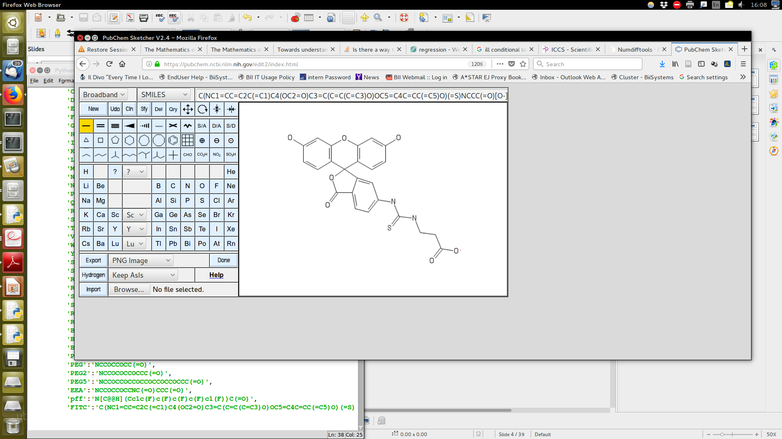
Development of an assay to quantify cellular uptake of peptides
FITC florescence tag followed by Beta-ala linker
Gives highly reproducible results among different batches of peptides synthesized

Slide 5
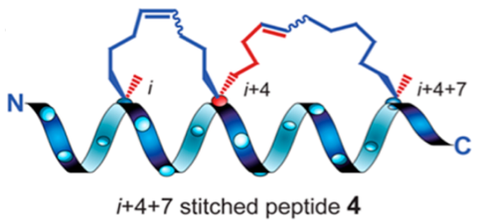
Data – 217 peptides
Unstapled (23)
Stapled, i-i+4 (86)
Stapled, i-i+7 (69)
Stitched (83)
Total (217) containing florescence intensity,
MW, logP, PI, formal charge at pH7.5

Slide 6
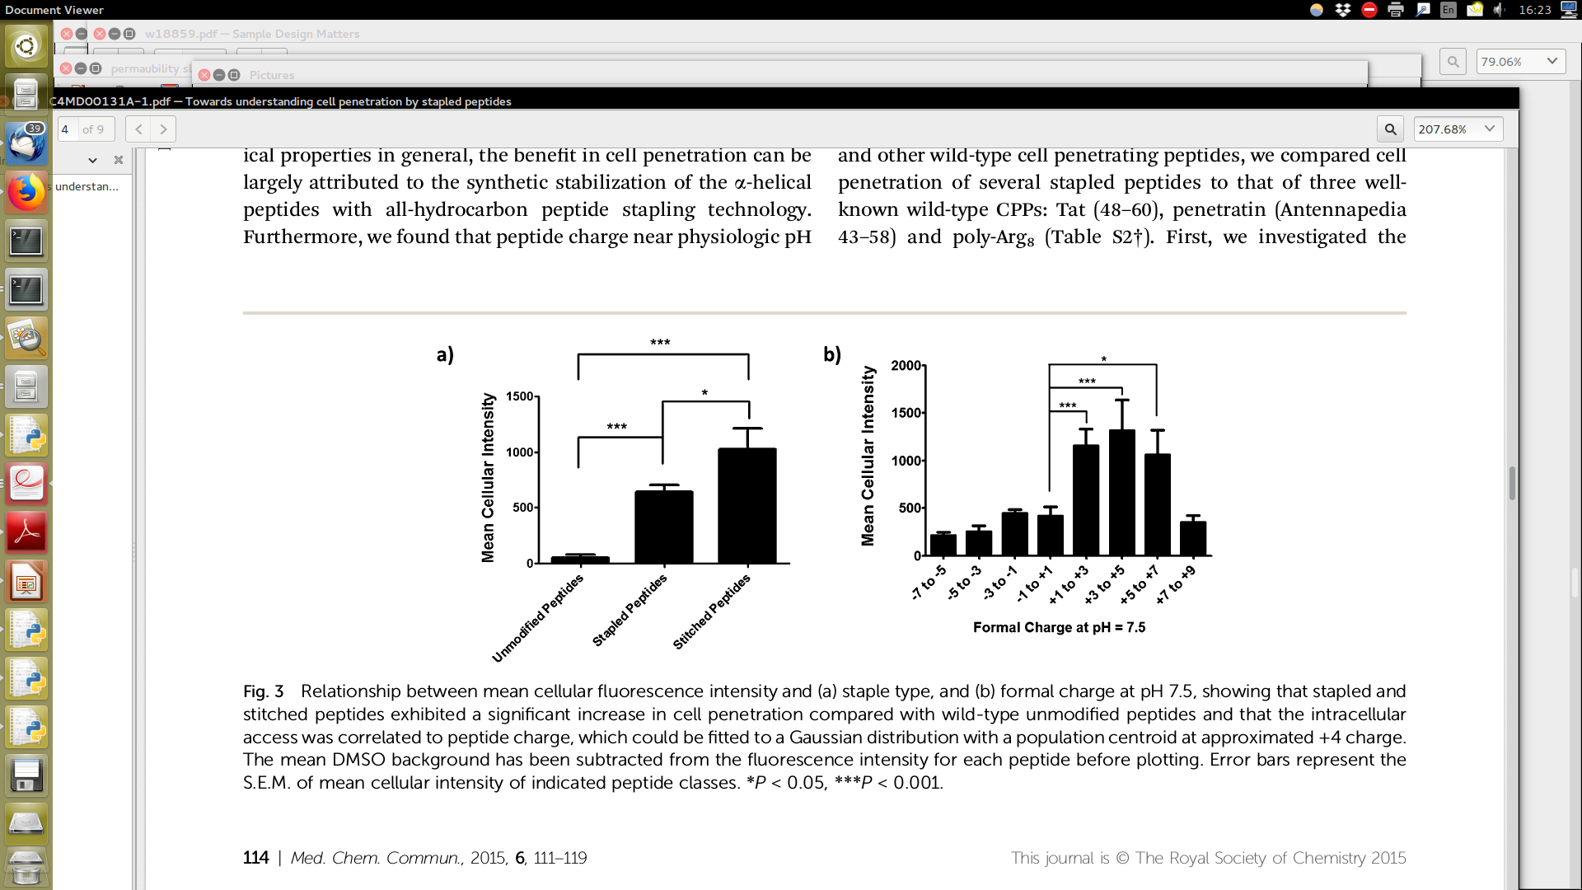
Results
Stapled peptides have higher permeability
Peptides with positive net charge have higher permeability

Slide 7
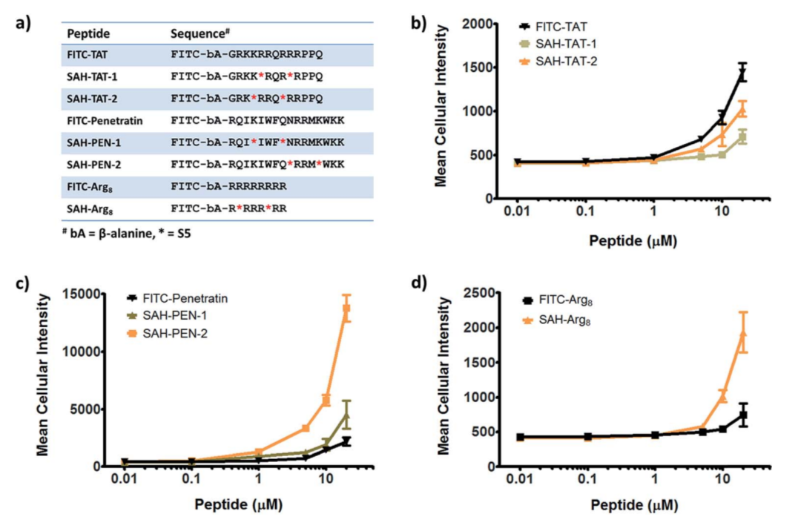
Stapling increases the cell permeability

Slide 8
Mechanistic study – penetration via ATP-dependent endocytosis
Peptide | Unstapled | Stapled
TAT | No change | Lower accumulation with ATP decrease
Penetratin | Lower accumulation with ATP decrease | Lower accumulation with ATP decrease
Poly-Arg₈ | No Change | Lower accumulation with ATP decrease
Possible different mechanisms for uptake by CPP and stapled peptides
Pathway involves sulfated proteogylcans using small molecule inhibitor and proteoglycan deficient cells

Slide 9
Comments
Paper validates mechanism of peptide cell permeability
Only three peptides studied with mechanism studies – I think there are more
Some peptides are largely similar, they should not be treated as independent samples

Slide 10
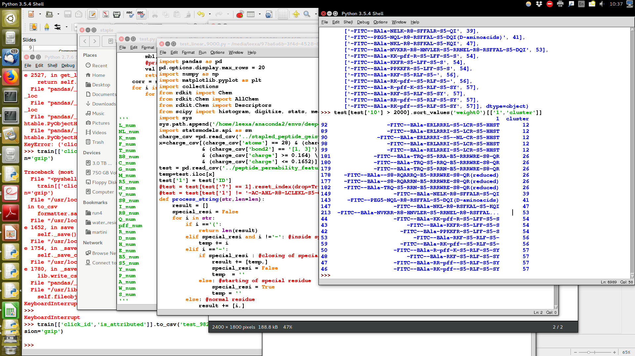
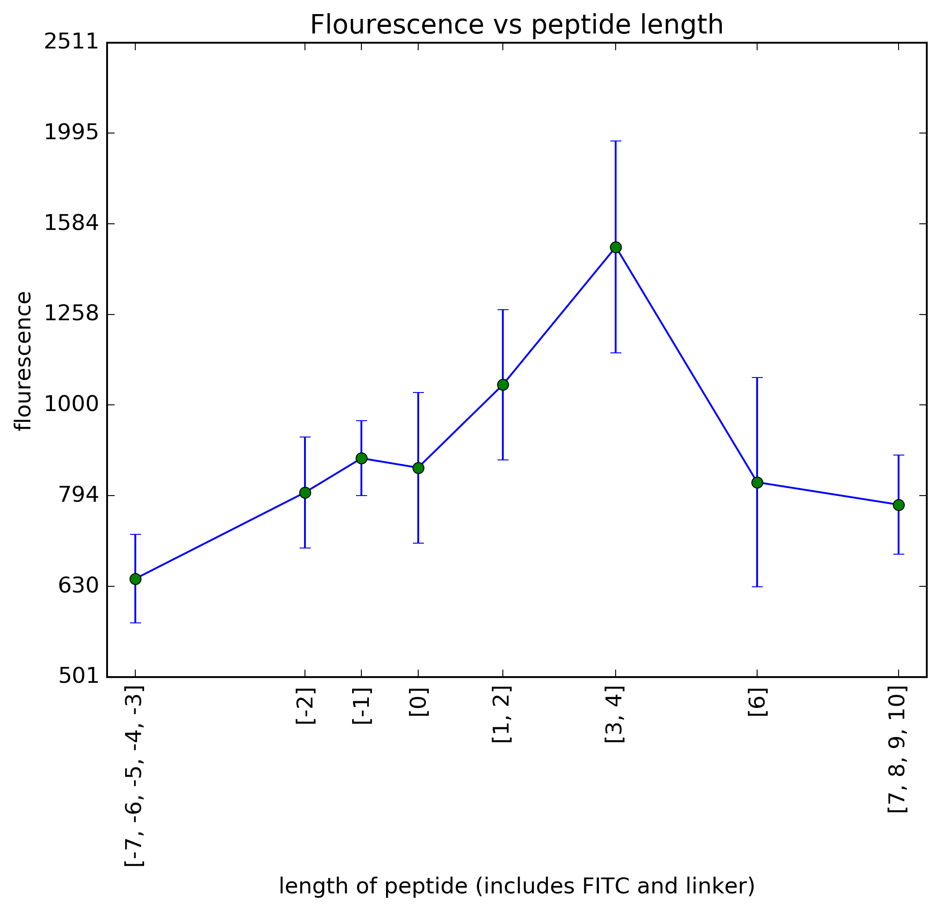
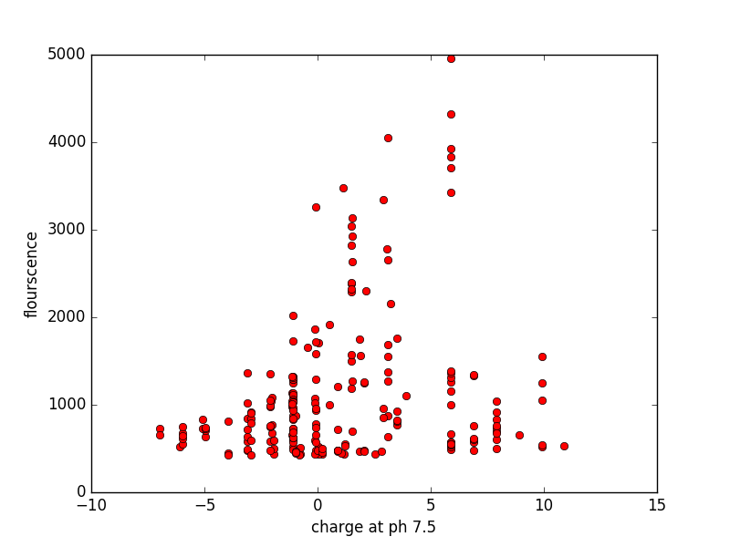
2. Data mining of stapled peptides
Data not independent and florescence spans orders of magnitude
Peptides with highest florescence > 2000 are
quite identical

Slide 11
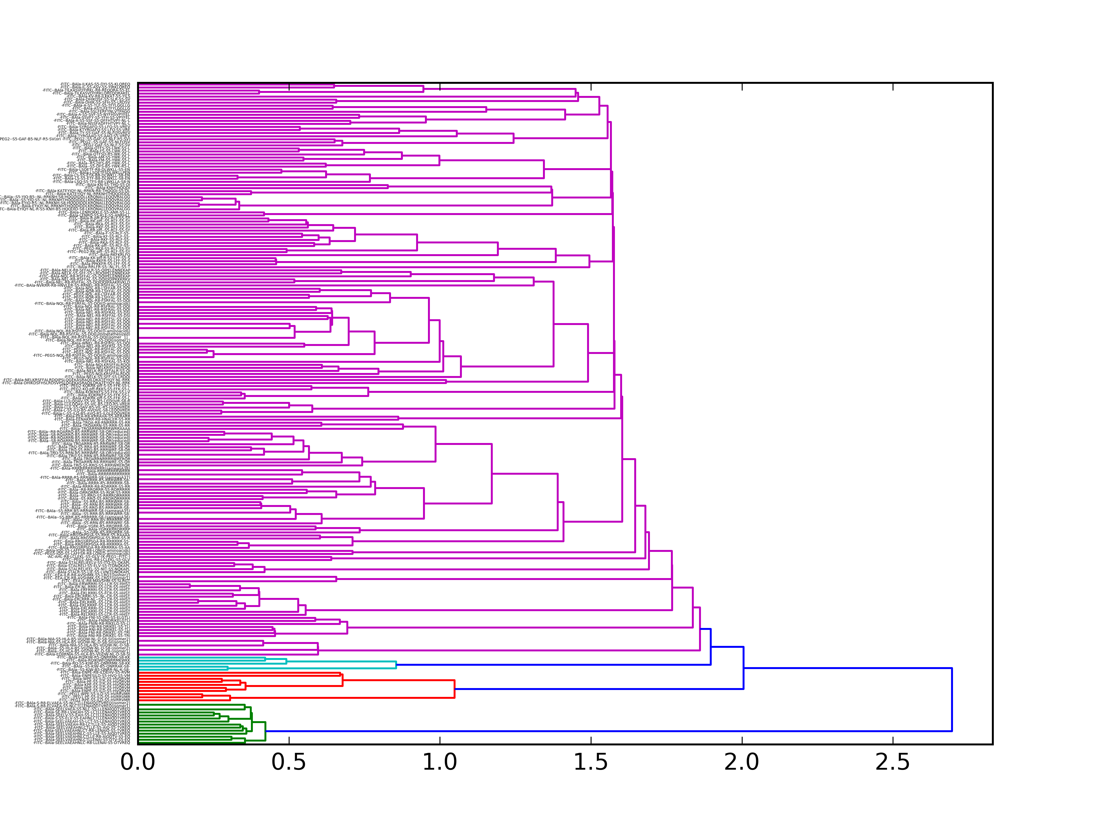
Treatment of correlated samples
Highly identical sequences just varying staple position
-FITC--BAla-S-S5-ELV-S5-EAHNLCTLLENAIQDTVREQ
-FITC--BAla-SEELV-S5-EAH-S5-LCTLLENAIQDTVREQ
-FITC--BAla-SEELVAEA-S5-NLC-S5-LLENAIQDTVREQ
-FITC--BAla-SEELVAEAH-S5-LCT-S5-LENAIQDTVREQ
-FITC--BAla-SEELVAEAHNLC-S5-LLE-S5-AIQDTVREQ
-FITC--BAla-SEELVAEAHNLCTLLE-S5-AIQ-S5-TVREQ
-FITC--BAla-SEELVAEAHNLCTLLENAI-S5-DTV-S5-EQ
-FITC--BAla-S-R8-ELVAEA-S5-NLCTLLENAIQDTVREQ(isomer1)
-FITC--BAla-S-R8-ELVAEA-S5-NLCTLLENAIQDTVREQ(isomer2)
-FITC--BAla-SE-R8-LVAEAH-S5-LCTLLENAIQDTVREQ
-FITC--BAla-SEELVAEAH-R8-LCTLLE-S5-AIQDTVREQ
-FITC--BAla-SEELVAEAHNLC-R8-LLENAI-S5-DTVREQ
-FITC--BAla-SEELVAEAHNLCT-R8-LENAIQ-S5-TVREQ
-FITC--BAla-SEELVAEAHNLCTLLE-R8-AIQDTV-S5-EQ

Slide 12
Dealing with non-independent samples
Perform hierarchal clustering based on seq identity. >70% identity as the cluster threshold distance cutoff. ~ 75 clusters
Each cluster given the weight of a single peptide building a weighted linear regression model.
70% is arbitrary, but it corresponds to
1. min of two different residues for small peptides
2. 20 identical residues for larger peptides

Slide 13
Model used
Simple weighted linear regression for all features
w_{i}Y_{i} = w_{i}B₁X_{i} + B₀
Features considered
1. Num, Norm, NormSA of each amino acid
2. 1,2,3,4 Moment of Gasteiger Charge distributions
3. Polar, nonpolar surface area
4. Number and % of HBA,HBD
5. Length, molecular weight

Slide 14
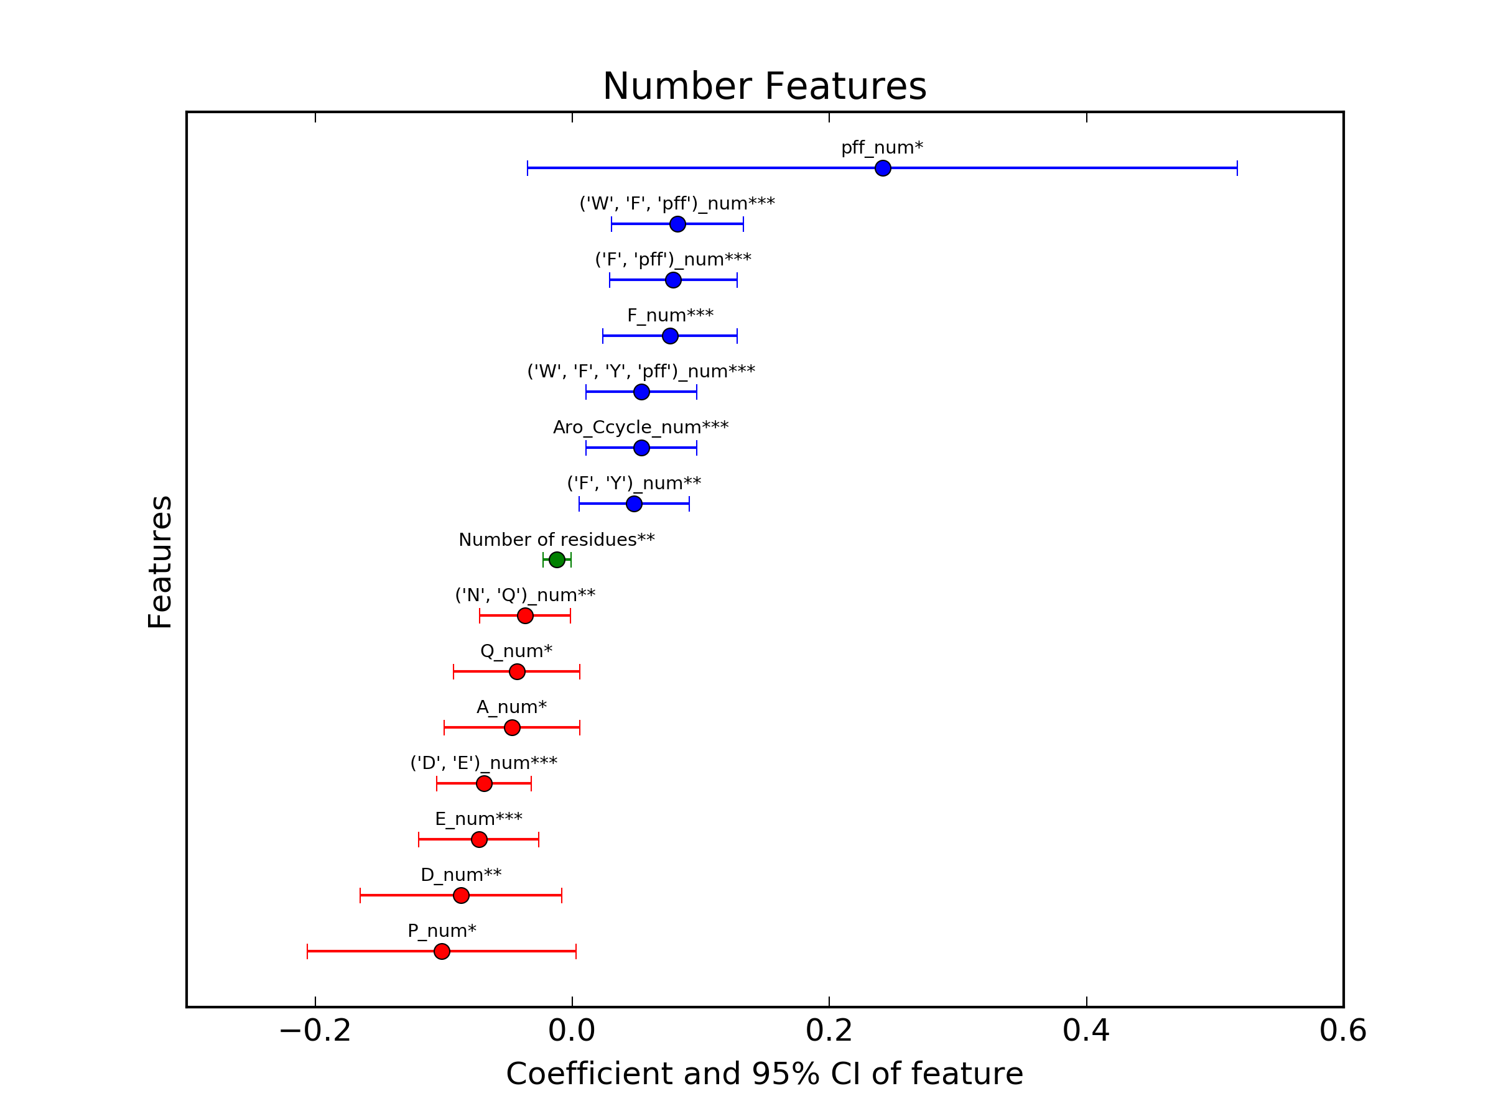
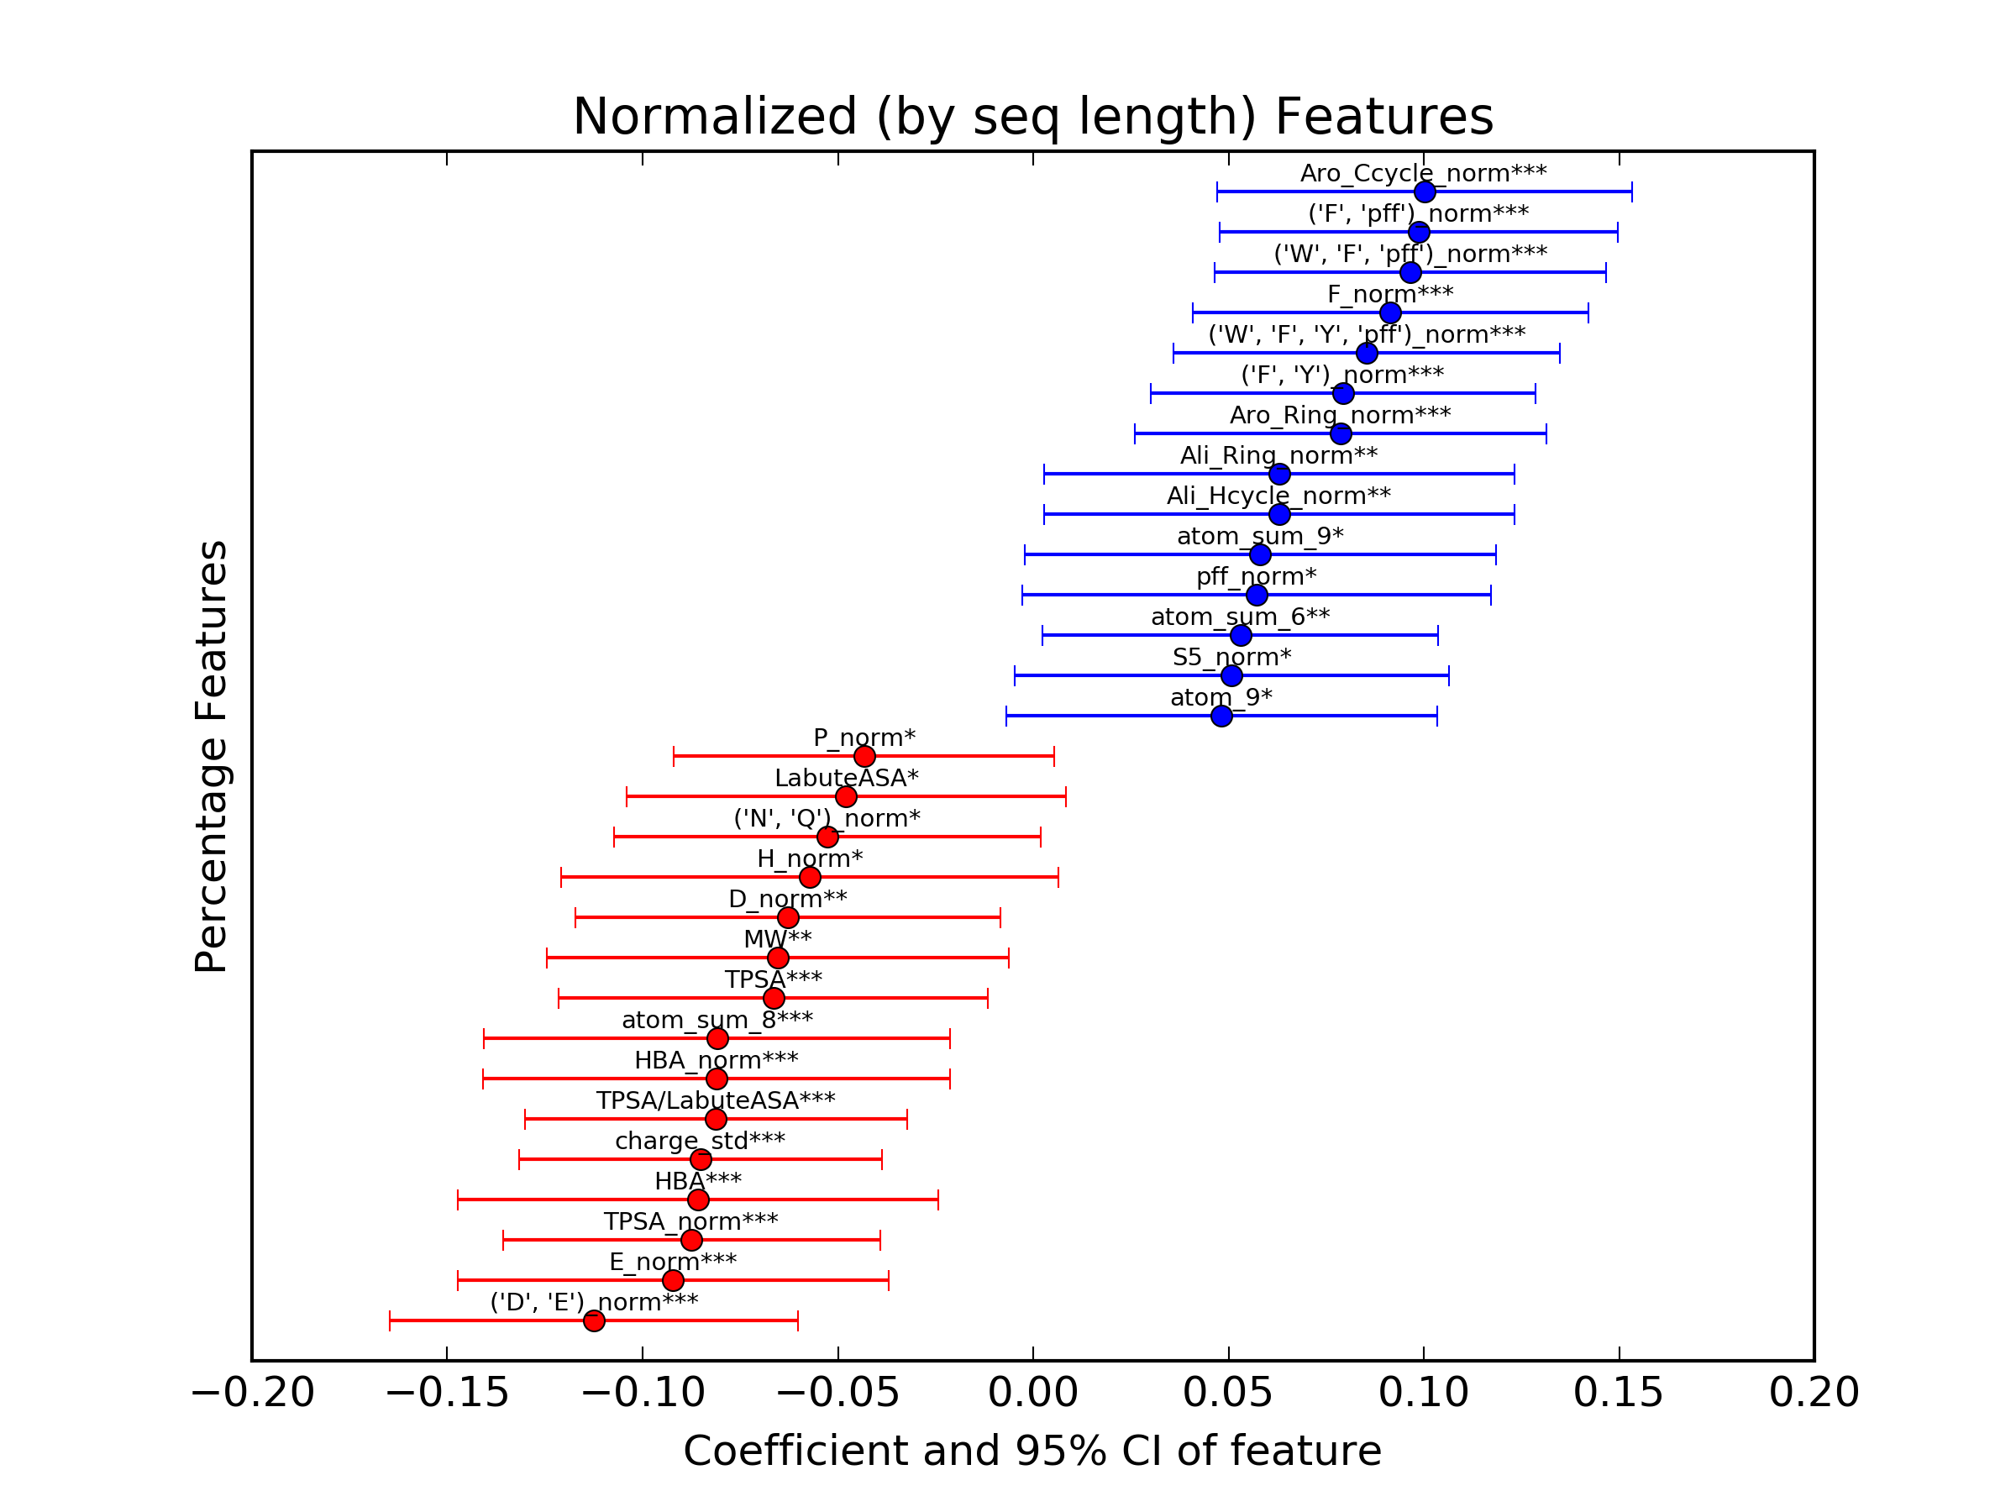
Only stapled peptides – Features
'F', 'Y')_normSA 0.0705 0.105
('F', 'Y')_norm 0.0793 0.124
('F', 'Y')_num 0.0479 0.064
('F', 'pff')_normSA 0.0949 0.161
('F', 'pff')_norm 0.0987 0.170
('F', 'pff')_num 0.0784 0.120
('W', 'F', 'Y', 'pff')_normSA 0.0778 0.121
('W', 'F', 'Y', 'pff')_norm 0.0853 0.140
('W', 'F', 'Y', 'pff')_num 0.0536 0.078
('W', 'F', 'pff')_normSA 0.0905 0.153
('W', 'F', 'pff')_norm 0.0965 0.169
('W', 'F', 'pff')_num 0.0815 0.121
FITC_normSA 0.0583 0.059
FITC_norm 0.0757 0.091
F_normSA 0.0855 0.138
F_norm 0.0914 0.151
F_num 0.0761 0.104
norm_Ali_Hcycle 0.0630 0.056
norm_Ali_Ring 0.0630 0.056
norm_Aro_Ccycle 0.1001 0.163
norm_Aro_Ring 0.0787 0.109
num_Aro_Ccycle 0.0536 0.078
num_Aro_Ring 0.0314 0.031
*,**,*** - sig of 0.1, 0.05, 0.02
Higher charged residues correlated to poorer permeability
Hydrophobic residues associated with better permeability

Slide 15
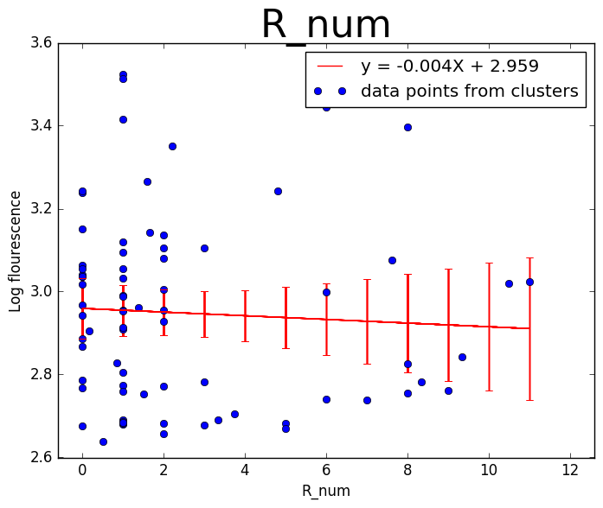
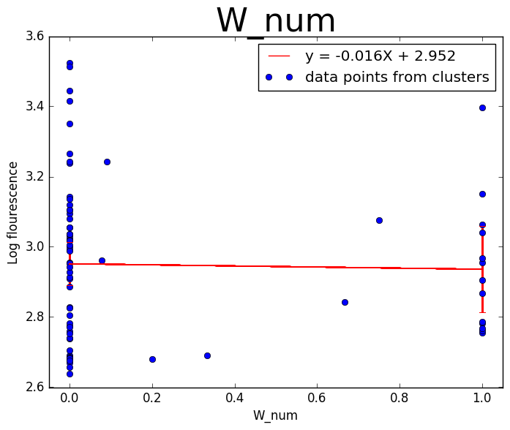
R, K, I, L, W ?
R and W are especially important for cell permeability for peptides (citation below)
Cell-penetrating peptides: 20 years later, where do we stand?FEBS Letters, Volume 587, Issue 12, 19 June 2013, Pages 1693-1702

Slide 16
Model prediction

